Slide 1
Decision Trees
Decision tree representation
Iterative Dichotomiser 3 (ID3) learning algorithm
Entropy, information gain
Overfitting
Notes:
ICS611-Foundations of A.I
Part7.3 Decision Tree Learning

Slide 2
Supplementary material
www
http://dms.irb.hr/tutorial/tut_dtrees.php
http://www.cs.uregina.ca/~dbd/cs831/notes/ml/dtrees/4_dtrees1.html

Slide 3
Decision Tree for PlayTennis
Outlook
Sunny
Overcast
Rain
Humidity
Yes
Wind
High
Normal
Strong
Weak
No
Yes
No
Yes

Slide 4
Decision Tree for PlayTennis
Outlook
Sunny
Overcast
Rain
Humidity
Each internal node tests an attribute
High
Normal
Each branch corresponds to an
attribute value node
No
Yes
Each leaf node assigns a classification

Slide 5
Decision Tree for PlayTennis
Outlook Temperature Humidity Wind PlayTennis
Sunny Hot High Weak ?
No
Outlook
Sunny
Overcast
Rain
Humidity
Yes
Wind
High
Normal
Strong
Weak
No
Yes
No
Yes

Slide 6
Decision Tree for Conjunction
Outlook=Sunny ∧ Wind=Weak
Outlook
Sunny
Overcast
Rain
Wind
No
No
Strong
Weak
No
Yes

Slide 7
Decision Tree for Disjunction
Outlook=Sunny ∨ Wind=Weak
Outlook
Sunny
Overcast
Rain
Yes
Wind
Wind
Strong
Weak
Strong
Weak
No
Yes
No
Yes

Slide 8
Decision Tree for XOR
Outlook=Sunny XOR Wind=Weak
Outlook
Sunny
Overcast
Rain
Wind
Wind
Wind
Strong
Weak
Strong
Weak
Strong
Weak
Yes
No
No
Yes
No
Yes

Slide 9
Decision Tree
decision trees represent disjunctions of conjunctions
Outlook
Sunny
Overcast
Rain
Humidity
Yes
Wind
High
Normal
Strong
Weak
No
Yes
No
Yes
(Outlook=Sunny ∧ Humidity=Normal)
∨ (Outlook=Overcast)
∨ (Outlook=Rain ∧ Wind=Weak)

Slide 10
When to consider Decision Trees
Instances describable by attribute-value pairs
Target function is discrete valued
Disjunctive hypothesis may be required
Possibly noisy training data
Missing attribute values
Examples:
  Medical diagnosis
  Credit risk analysis
  Object classification for robot manipulator (Tan 1993)

Slide 11
Top-Down Induction of Decision Trees ID3
In decision tree learning, ID3 (Iterative Dichotomiser 3) is an algorithm used to generate a decision tree invented by Ross Quinlan
A ← the “best” decision attribute for next node
Assign A as decision attribute for node
For each value of A create new descendant
Sort training examples to leaf node according to
the attribute value of the branch
If all training examples are perfectly classified (same value of target attribute) stop, else iterate over new leaf nodes.

Slide 12
Which Attribute is ”best”?
[29+,35-]
A₁=?
A₂=?
[29+,35-]
True
False
True
False
[21+, 5-]
[8+, 30-]
[18+, 33-]
[11+, 2-]

Slide 13
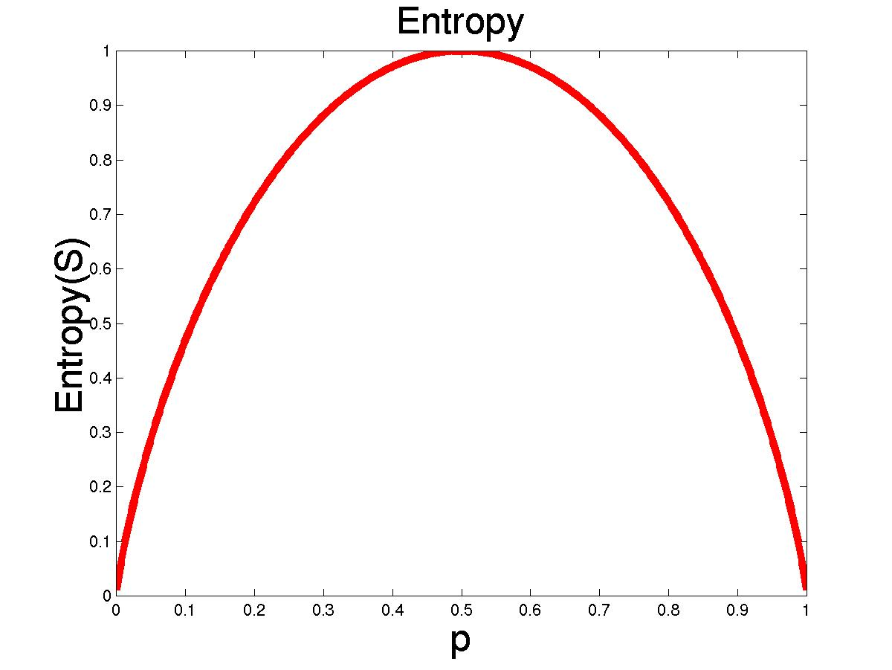
Entropy
S is a sample of training examples
p₊ is the proportion of positive examples
p₋ is the proportion of negative examples
Entropy measures the impurity of S
  Entropy(S) = -p₊ log₂ p₊ - p₋ log₂ p₋

Slide 14
Entropy
Entropy(S)= expected number of bits needed to encode class (+ or -) of randomly drawn members of S (under the optimal, shortest length-code)
Why?
Information theory optimal length code assign
–log₂ p bits to messages having probability p.
So the expected number of bits to encode
(+ or -) of random member of S:
  -p₊ log₂ p₊ - p₋ log₂ p₋

Slide 15
Information Gain
Gain(S,A): expected reduction in entropy due to sorting S on attribute A
Gain(S,A)=Entropy(S) - ∑_{v∈values(A)} |S_{v}|/|S| Entropy(S_{v})
Entropy([29+,35-]) = -29/64 log₂ 29/64 – 35/64 log₂ 35/64
= 0.99
[29+,35-]
A₁=?
A₂=?
[29+,35-]
True
False
True
False
[21+, 5-]
[8+, 30-]
[18+, 33-]
[11+, 2-]

Slide 16
Information Gain
Entropy([18+,33-]) = 0.94
Entropy([8+,30-]) = 0.62
Gain(S,A₂)=Entropy(S)
-51/64*Entropy([18+,33-])
-13/64*Entropy([11+,2-])
=0.12
Entropy([21+,5-]) = 0.71
Entropy([8+,30-]) = 0.74
Gain(S,A₁)=Entropy(S)
-26/64*Entropy([21+,5-])
-38/64*Entropy([8+,30-])
=0.27
[29+,35-]
A₁=?
A₂=?
[29+,35-]
True
False
True
False
[21+, 5-]
[8+, 30-]
[18+, 33-]
[11+, 2-]

Slide 17
Training Examples
Day
Outlook
Temp.
Humidity
Wind
Play Tennis
D1
Sunny
Hot
High
Weak
No
D2
Sunny
Hot
High
Strong
No
D3
Overcast
Hot
High
Weak
Yes
D4
Rain
Mild
High
Weak
Yes
D5
Rain
Cool
Normal
Weak
Yes
D6
Rain
Cool
Normal
Strong
No
D7
Overcast
Cool
Normal
Weak
Yes
D8
Sunny
Mild
High
Weak
No
D9
Sunny
Cold
Normal
Weak
Yes
D10
Rain
Mild
Normal
Strong
Yes
D11
Sunny
Mild
Normal
Strong
Yes
D12
Overcast
Mild
High
Strong
Yes
D13
Overcast
Hot
Normal
Weak
Yes
D14
Rain
Mild
High
Strong
No

Slide 18
Selecting the Next Attribute
S=[9+,5-]
E=0.940
S=[9+,5-]
E=0.940
Humidity
Wind
High
Normal
Weak
Strong
[3+, 4-]
[6+, 1-]
[6+, 2-]
[3+, 3-]
E=0.592
E=0.811
E=0.985
E=1.0
Gain(S,Humidity)
=0.940-(7/14)*0.985
– (7/14)*0.592
=0.151
Gain(S,Wind)
=0.940-(8/14)*0.811
– (6/14)*1.0
=0.048
Humidity provides greater info. gain than Wind, w.r.t target classification.

Slide 19
Selecting the Next Attribute
S=[9+,5-]
E=0.940
Outlook
Over
cast
Sunny
Rain
[2+, 3-]
[4+, 0]
[3+, 2-]
E=0.971
E=0.0
E=0.971
Gain(S,Outlook)
=0.940-(5/14)*0.971
-(4/14)*0.0 – (5/14)*0.0971
=0.247

Slide 20
Selecting the Next Attribute
The information gain values for the 4 attributes are:
Gain(S,Outlook) =0.247
Gain(S,Humidity) =0.151
Gain(S,Wind) =0.048
Gain(S,Temperature) =0.029
where S denotes the collection of training examples

Slide 21
ID3 Algorithm
[D1,D2,…,D14]
[9+,5-]
Outlook
Sunny
Overcast
Rain
S_{sunny}=[D1,D2,D8,D9,D11]
[2+,3-]
[D3,D7,D12,D13]
[4+,0-]
[D4,D5,D6,D10,D14]
[3+,2-]
?
Yes
?
Gain(S_{sunny} , Humidity)=0.970-(3/5)0.0 – 2/5(0.0) = 0.970
Gain(S_{sunny} , Temp.)=0.970-(2/5)0.0 –2/5(1.0)-(1/5)0.0 = 0.570
Gain(S_{sunny} , Wind)=0.970= -(2/5)1.0 – 3/5(0.918) = 0.019

Slide 22
ID3 Algorithm
Outlook
Sunny
Overcast
Rain
Humidity
Yes
Wind
[D3,D7,D12,D13]
High
Normal
Strong
Weak
No
Yes
No
Yes
[D1,D2]
[D8,D9,D11]
[D6,D14]
[D4,D5,D10]

Slide 23
Occam’s Razor
"Pluralitas non est ponenda sine neccesitate" or "plurality should not be posited without necessity.“William of Ockham (ca. 1285-1349)
Why prefer short hypotheses?
Argument in favor:
  Fewer short hypotheses than long hypotheses
  A short hypothesis that fits the data is unlikely to be a coincidence
  A long hypothesis that fits the data might be a coincidence
Argument opposed:
  There are many ways to define small sets of hypotheses
  E.g. All trees with a prime number of nodes that use attributes beginning with ”Z”
  What is so special about small sets based on size of hypothesis

Slide 24
Overfitting
One of the biggest problems with decision trees is Overfitting

Slide 25
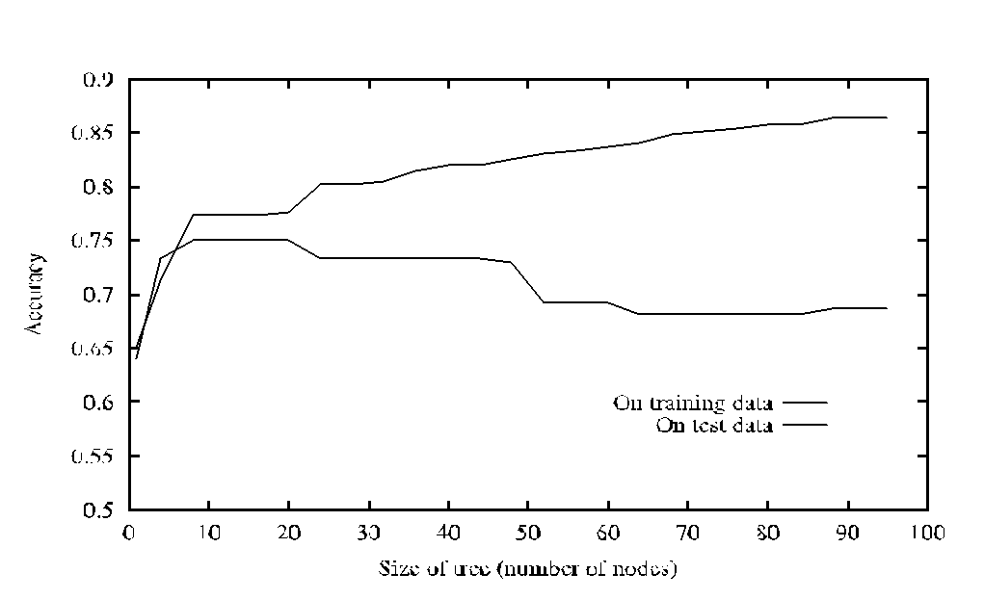
Overfitting in Decision Tree Learning

Slide 26
Avoid Overfitting
How can we avoid overfitting?
Stop growing when data split not statistically significant
Grow full tree then post-prune
Minimum description length (MDL):
  Minimize:
  size(tree) + size(misclassifications(tree))

Slide 27
Reduced-Error Pruning
Split data into training and validation set
Do until further pruning is harmful:
Evaluate impact on validation set of pruning each possible node (plus those below it)
Greedily remove the one that most improves the validation set accuracy
Produces smallest version of most accurate subtree

Slide 28
Rule-Post Pruning
Infer the decision tree from the training set, growing the tree until the training data is fit as well as possible and allowing over-fitting to occur.
Convert the learned tree into an equivalent set of rules by creating one rule for each path from the root node to a leaf node.
Prune (generalize) each rule by removing any preconditions that result in improving its estimated accuracy.
Sort the pruned rules by their estimated accuracy, and consider them in this sequence when classifying subsequent instances.

Slide 29
Converting a Tree to Rules
Outlook
Sunny
Overcast
Rain
Humidity
Yes
Wind
High
Normal
Strong
Weak
No
Yes
No
Yes
R₁: If (Outlook=Sunny) ∧ (Humidity=High) Then PlayTennis=No
R₂: If (Outlook=Sunny) ∧ (Humidity=Normal) Then PlayTennis=Yes
R₃: If (Outlook=Overcast) Then PlayTennis=Yes
R₄: If (Outlook=Rain) ∧ (Wind=Strong) Then PlayTennis=No
R₅: If (Outlook=Rain) ∧ (Wind=Weak) Then PlayTennis=Yes

Slide 30
Continuous Valued Attributes
Create a discrete attribute to test continuous
Temperature = 24.5⁰C
(Temperature > 20.0⁰C) = {true, false}
Where to set the threshold?
Temperature
15⁰C
18⁰C
19⁰C
22⁰C
24⁰C
27⁰C
PlayTennis
No
No
Yes
Yes
Yes
No
(see paper by [Fayyad, Irani 1993]

Slide 31
Attributes with many Values
Problem: if an attribute has many values, maximizing InformationGain will select it.
E.g.: Imagine using Date=27.3.2002 as attribute
perfectly splits the data into subsets of size 1
A Solution:
Use GainRatio instead of information gain as criteria:
GainRatio(S,A) = Gain(S,A) / SplitInformation(S,A)
SplitInformation(S,A) = -Σ_{i=1..c} |S_{i}|/|S| log₂ |S_{i}|/|S|
Where S_{i} is the subset for which attribute A has the value v_{i}

Slide 32
Cross-Validation
Estimate the accuracy of a hypothesis induced by a supervised learning algorithm
Predict the accuracy of a hypothesis over future unseen instances
Select the optimal hypothesis from a given set of alternative hypotheses
  Pruning decision trees
  Model selection
  Feature selection
Combining multiple classifiers (boosting)

Slide 33
Cross-Validation
k-fold cross-validation splits the data set D into k mutually exclusive subsets D₁,D₂,…,D_{k}
Train and test the learning algorithm k times, each time it is trained on D\D_{i} and tested on D_{i}
D₁
D₂
D₃
D₄
D₁
D₂
D₃
D₄
D₁
D₂
D₃
D₄
D₁
D₂
D₃
D₄
D₁
D₂
D₃
D₄
acc_{cv} = 1/n ∑ _{(vi,yi)∈D} δ(I(D\D_{i},v_{i}),y_{i})

Slide 34
Cross-Validation
Uses all the data for training and testing
Complete k-fold cross-validation splits the dataset of size m in all (m over m/k) possible ways (choosing m/k instances out of m)
Leave n-out cross-validation sets n instances aside for testing and uses the remaining ones for training (leave one-out is equivalent to n-fold cross-validation)

